Slide 1
Digital Rhetoric
Online Presence Presentations
Fall 2023

Slide 2


Developing an Original Game
Originates from my own interest in fantasy/magic and interaction
Explore new digital communities
Learning as I create
Difficulties of creating interaction
Work progress vs. visibility

Slide 3
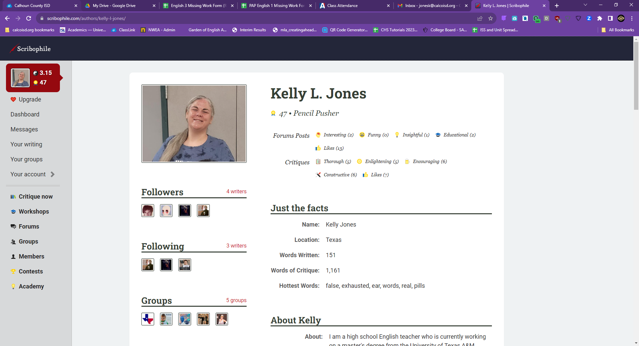
Let’s check out Scribophile together!

Slide 4

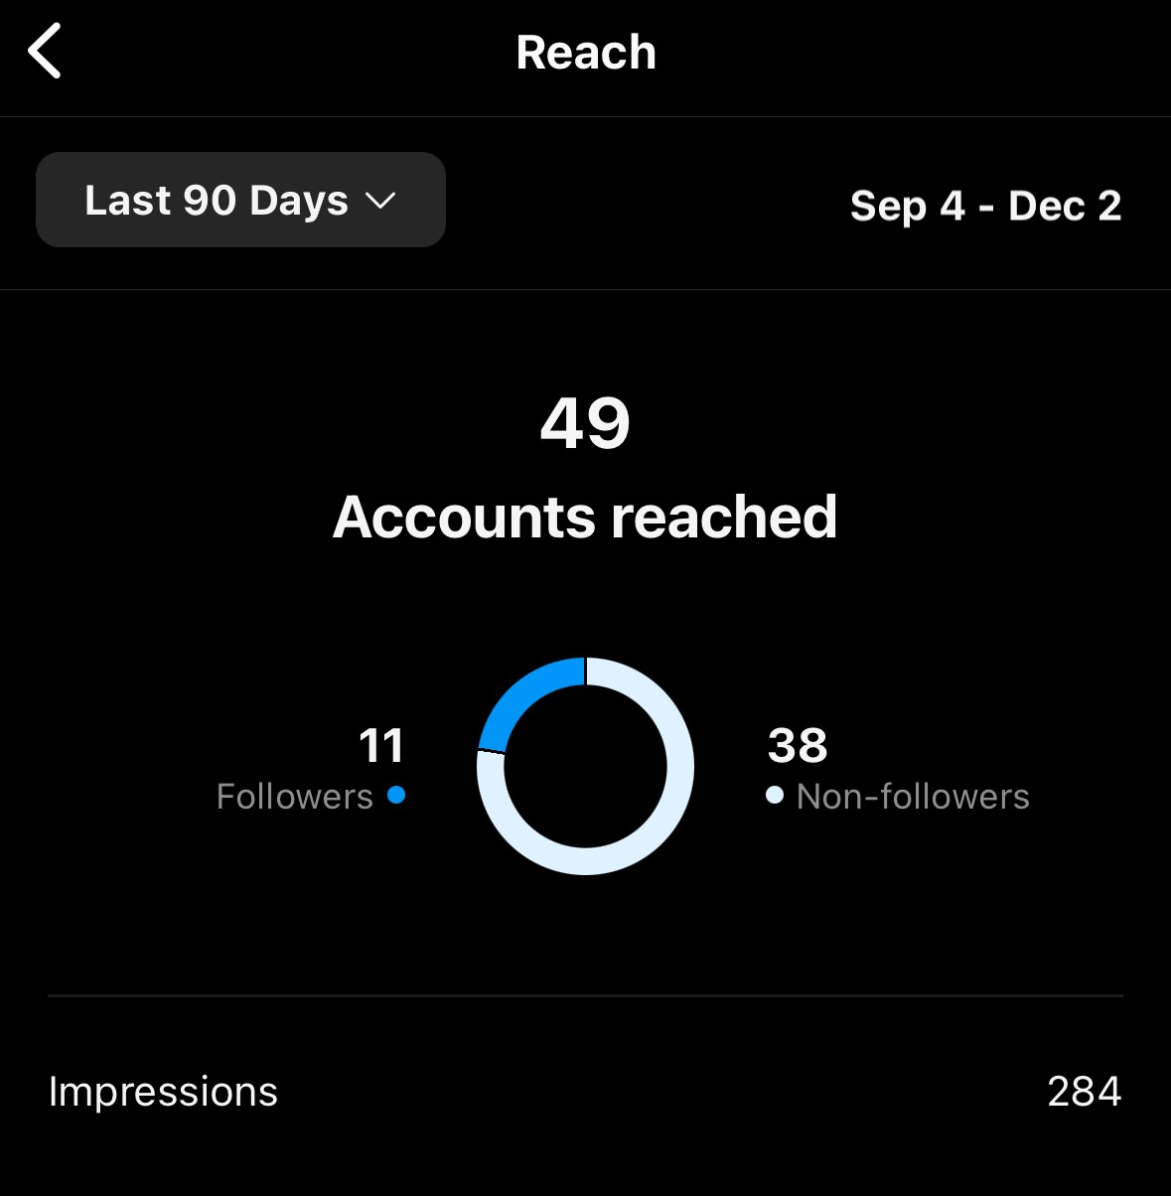
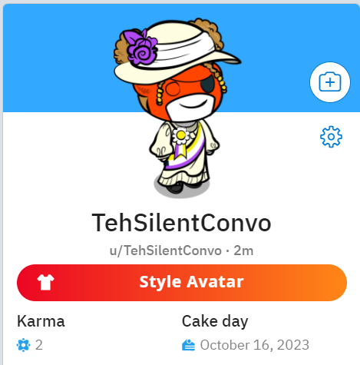


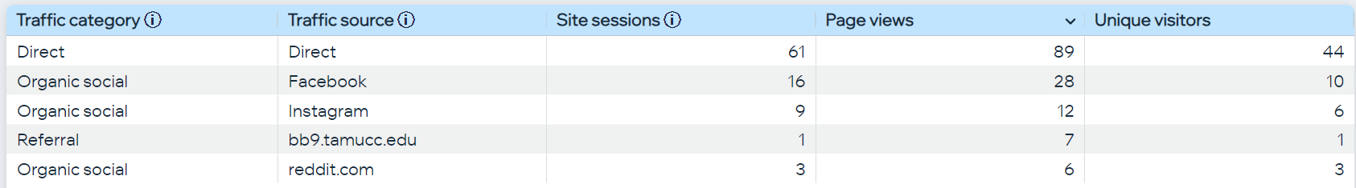
A Creative Writing Portfolio
https://www.thesilentconversationist.com/
@thesilentconversationist
Instagram Analytics: Sept. 4 to Dec. 3
Reddit Karma ^
Site Analytics: Sept. 5 to Dec. 3

Slide 5
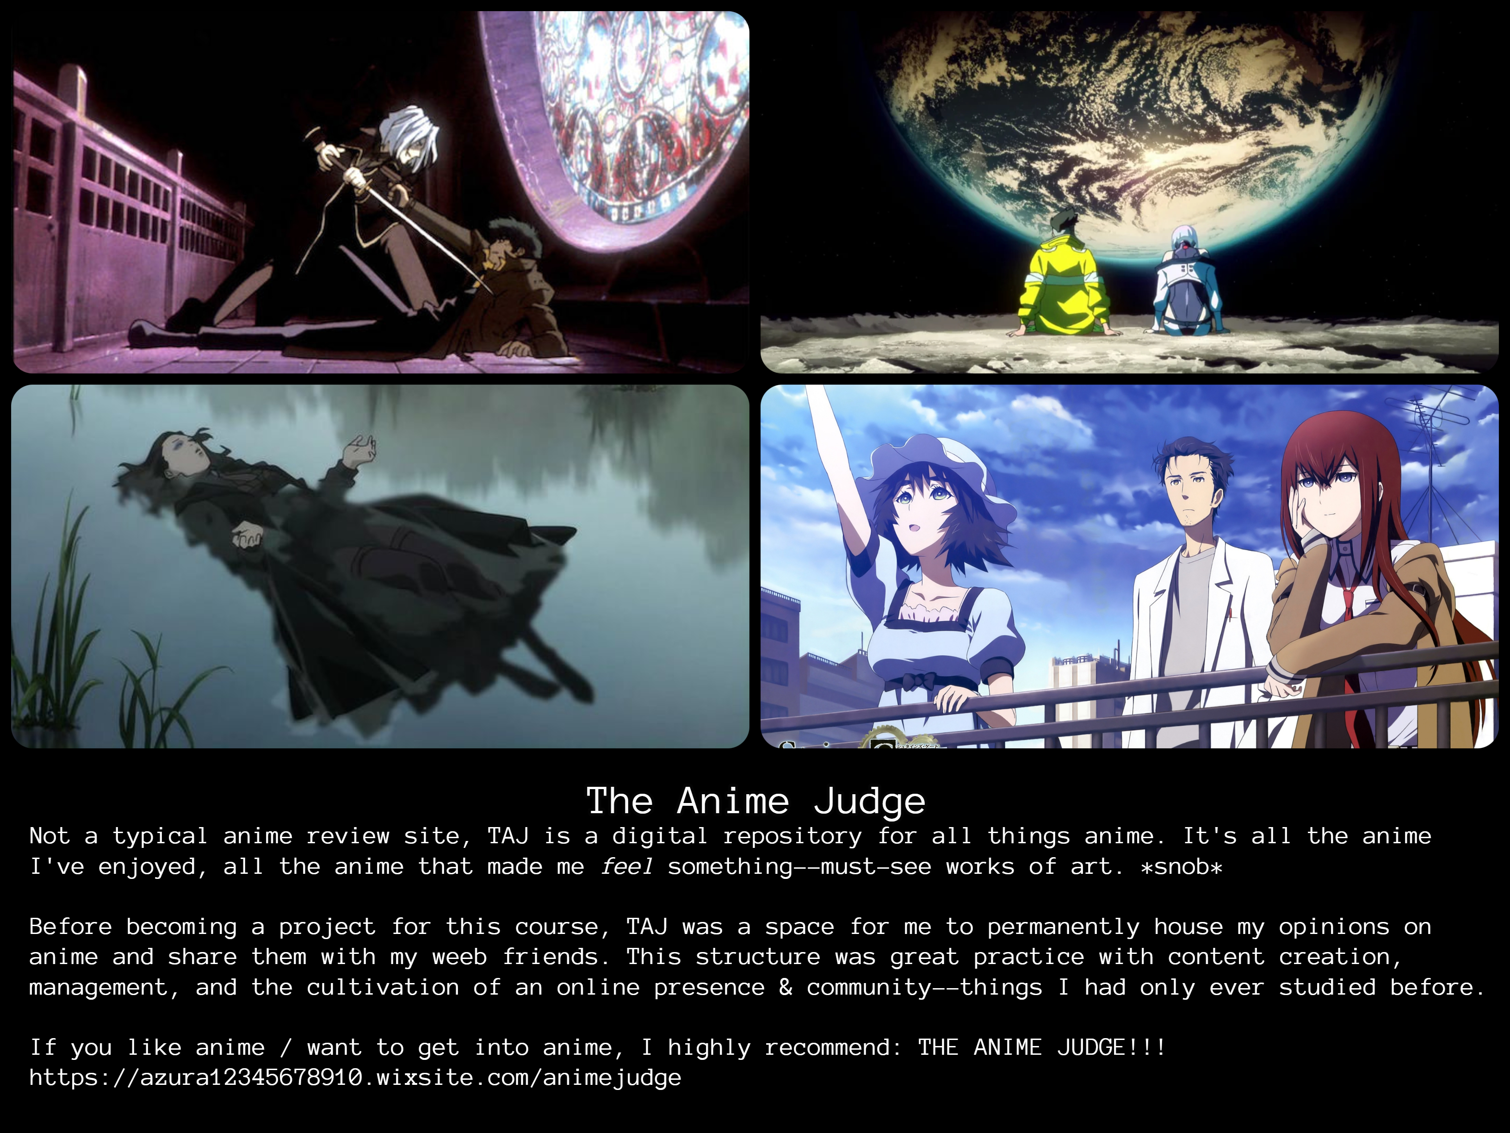

←Terrible link

Slide 6
ONLINE PRESENCE PROJECT
FOR
MONDAY MOTIVATION
DO’s DON’T’s
BE CREATIVE BE AFRAID TO ASK QUESTIONS
BE PERSISTENT FEEL LIKE YOU FAILED
BE PATIENT GIVE UP—KEEP GOING
BE CONSISTENT LET DOUBT WIN
INVOLVE FRIENDS/FAMILY IGNORE YOUR AUDIENCE
BE UNIQUE PICK TOO MANY TOPICS

Slide 7
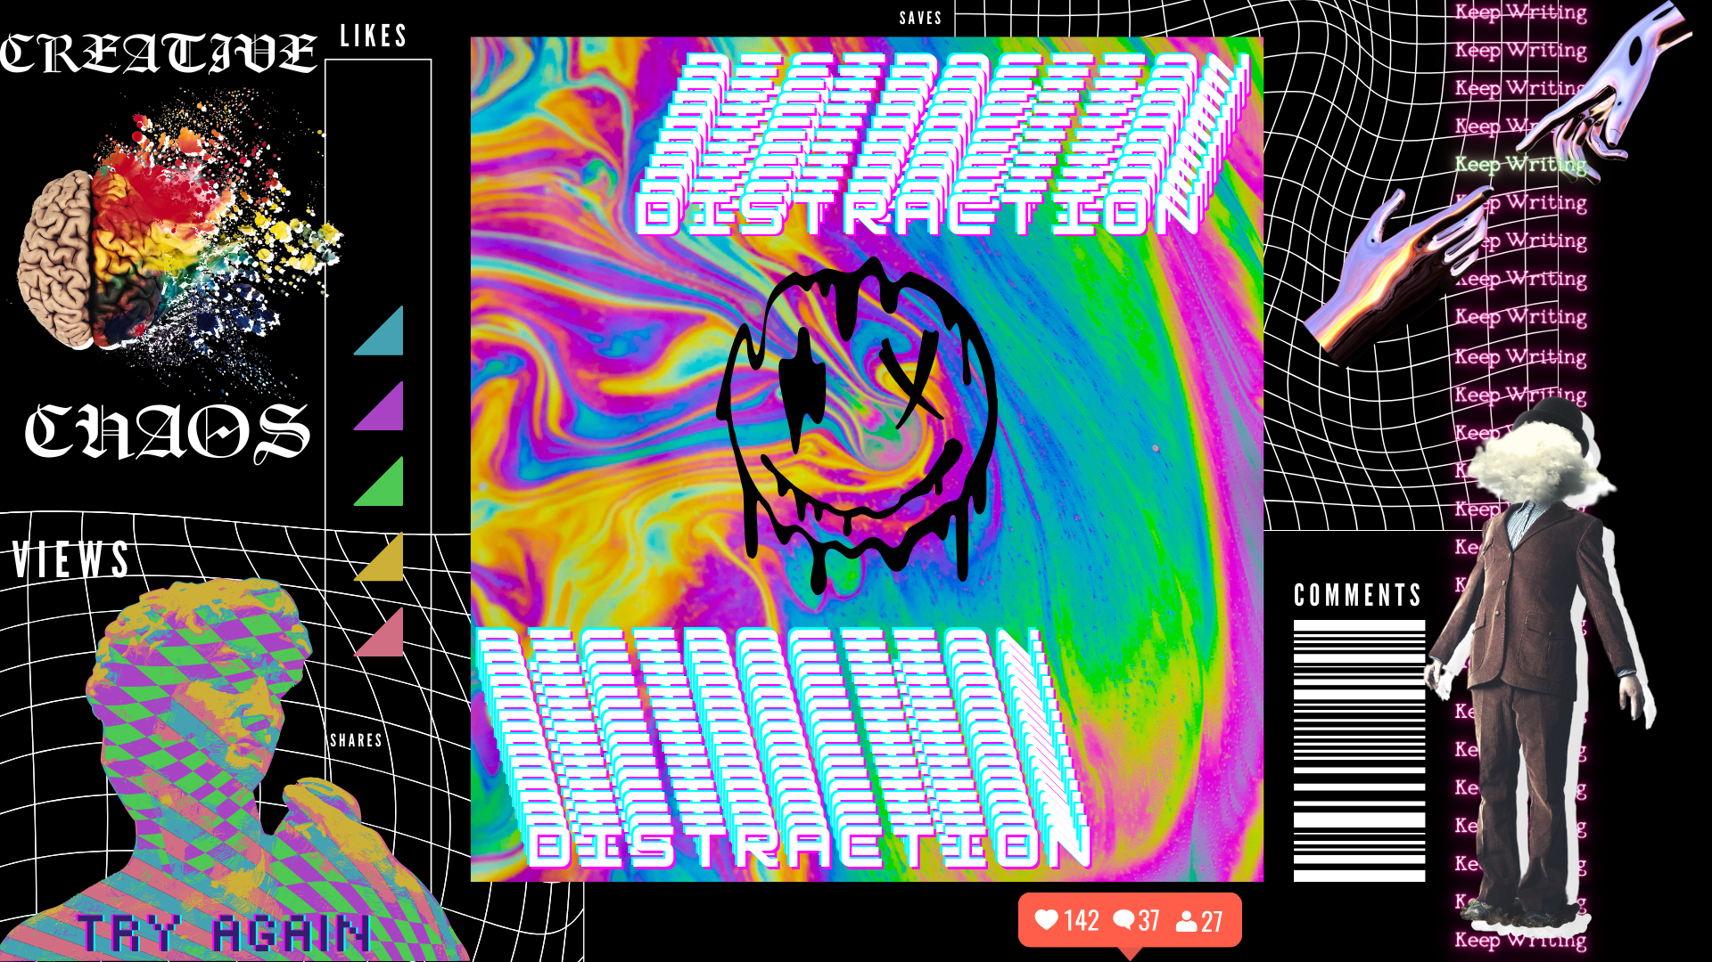

Slide 8
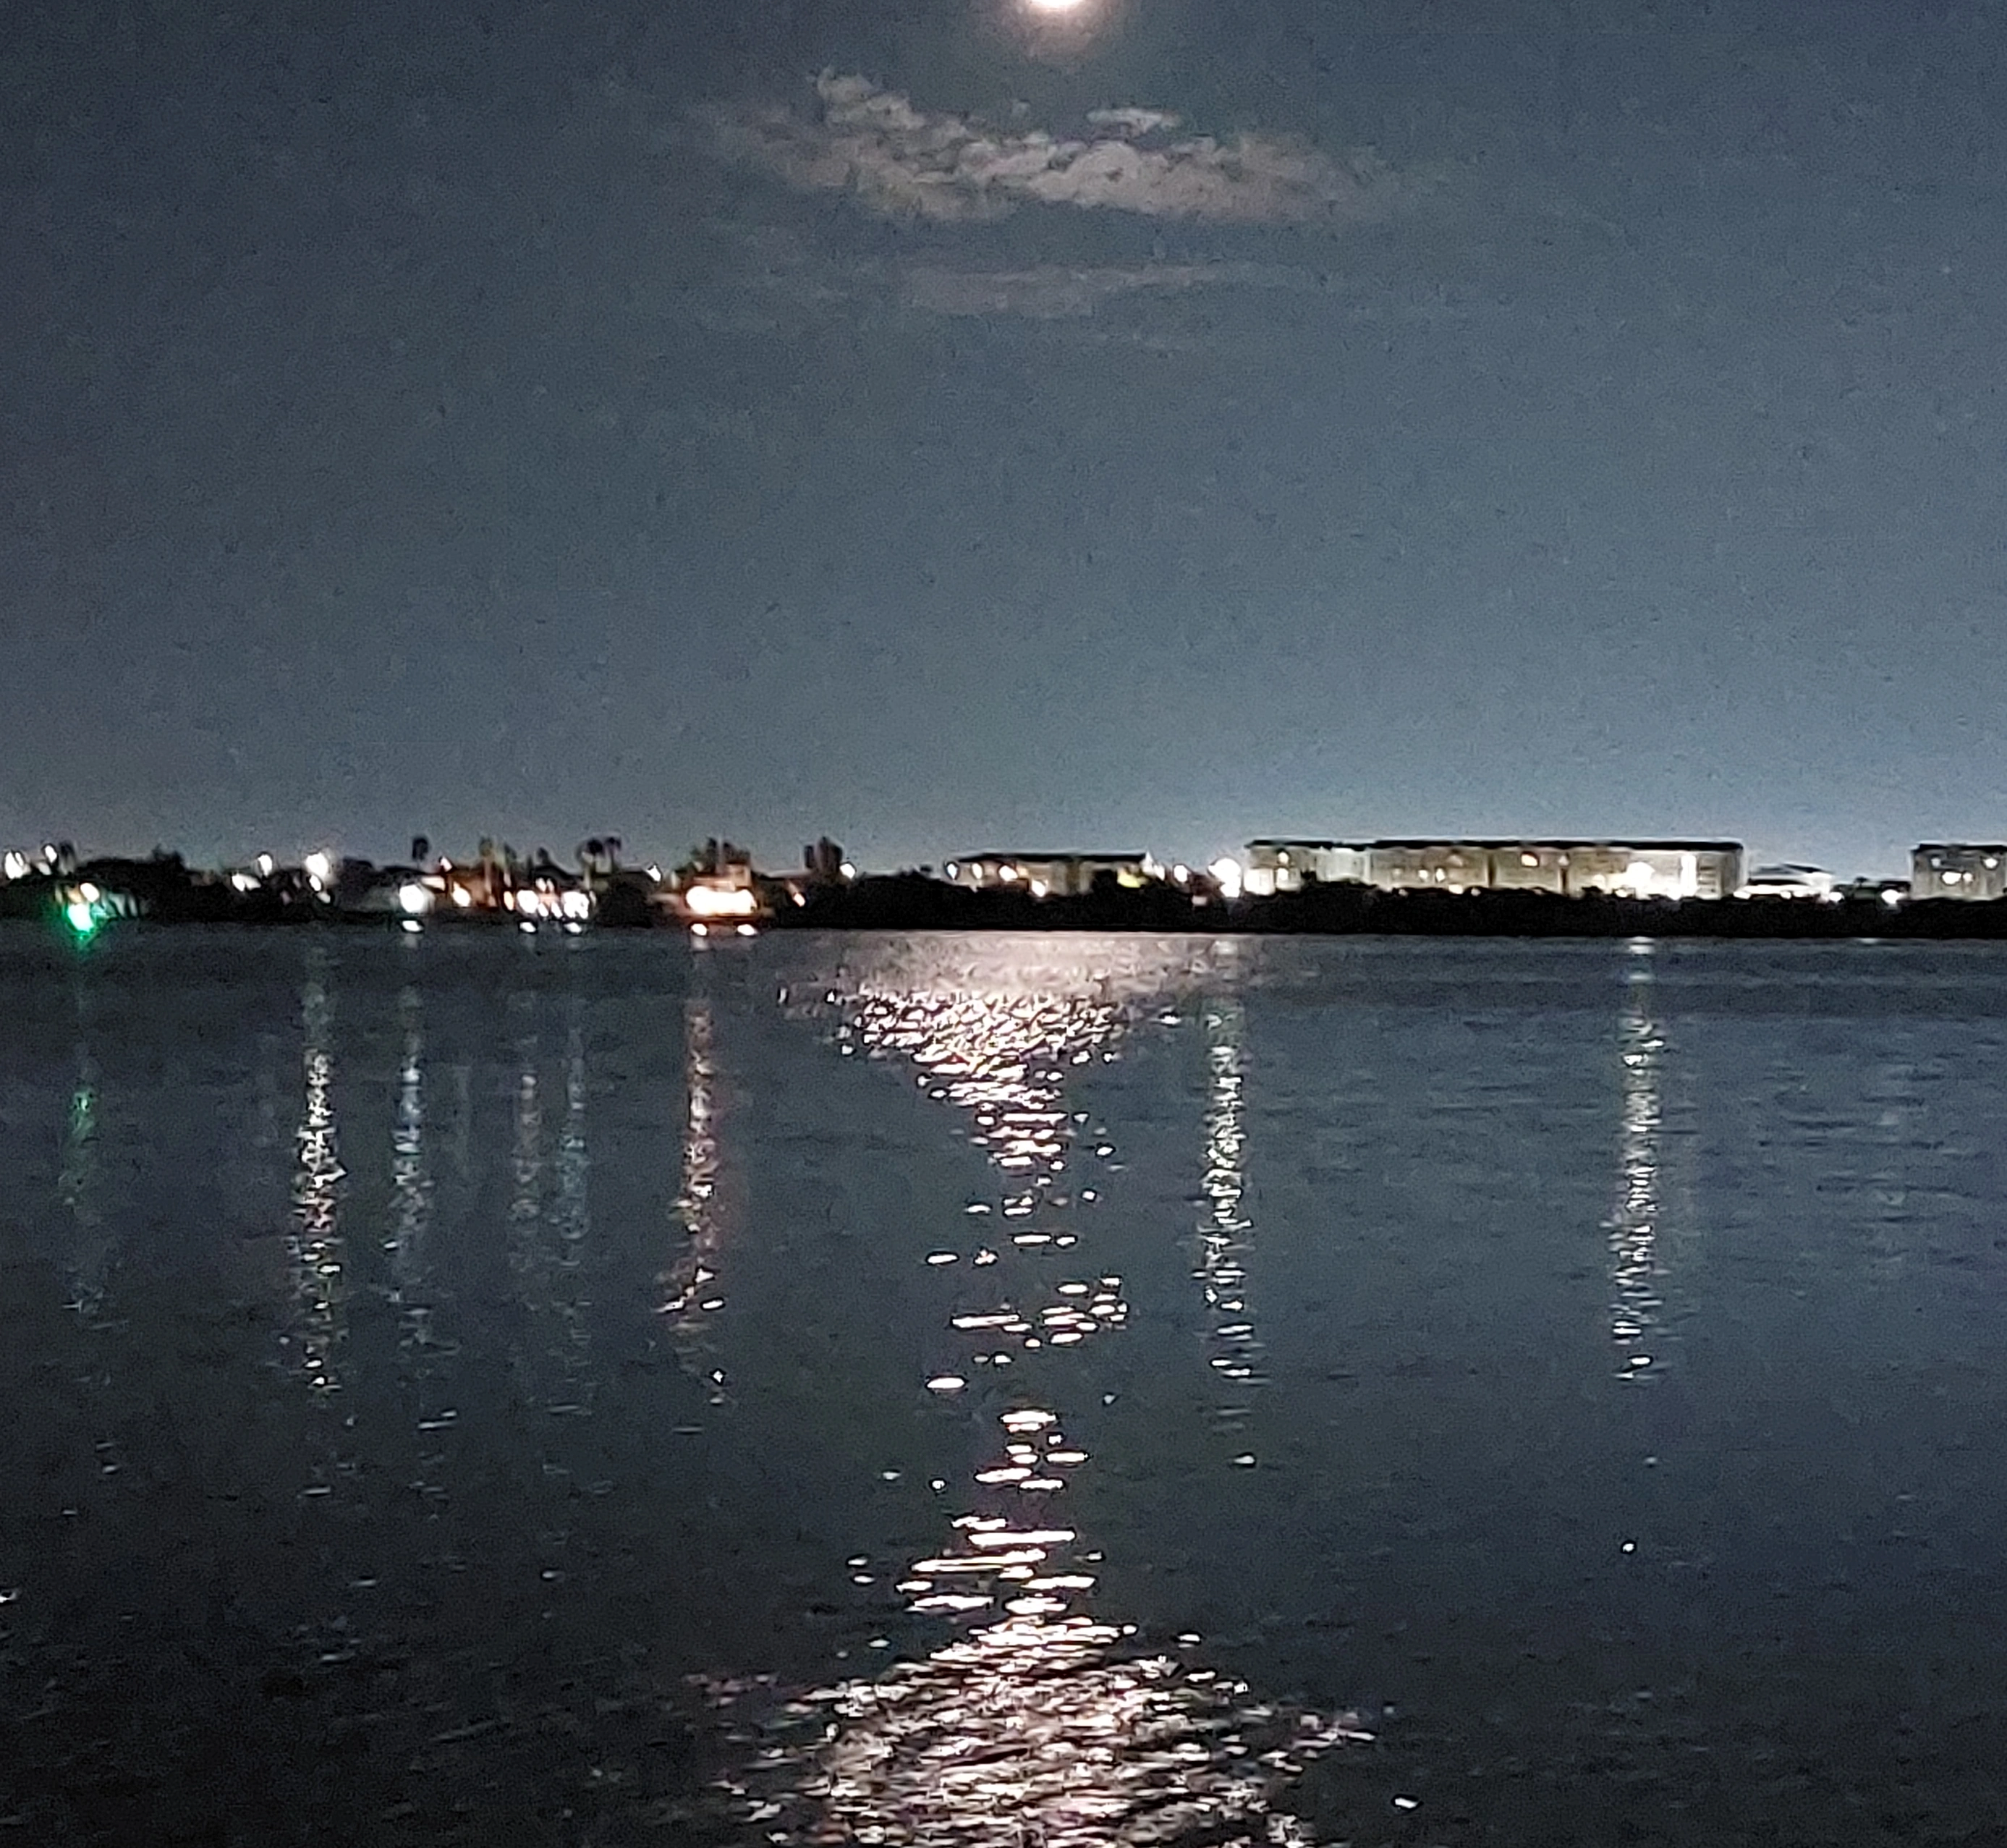
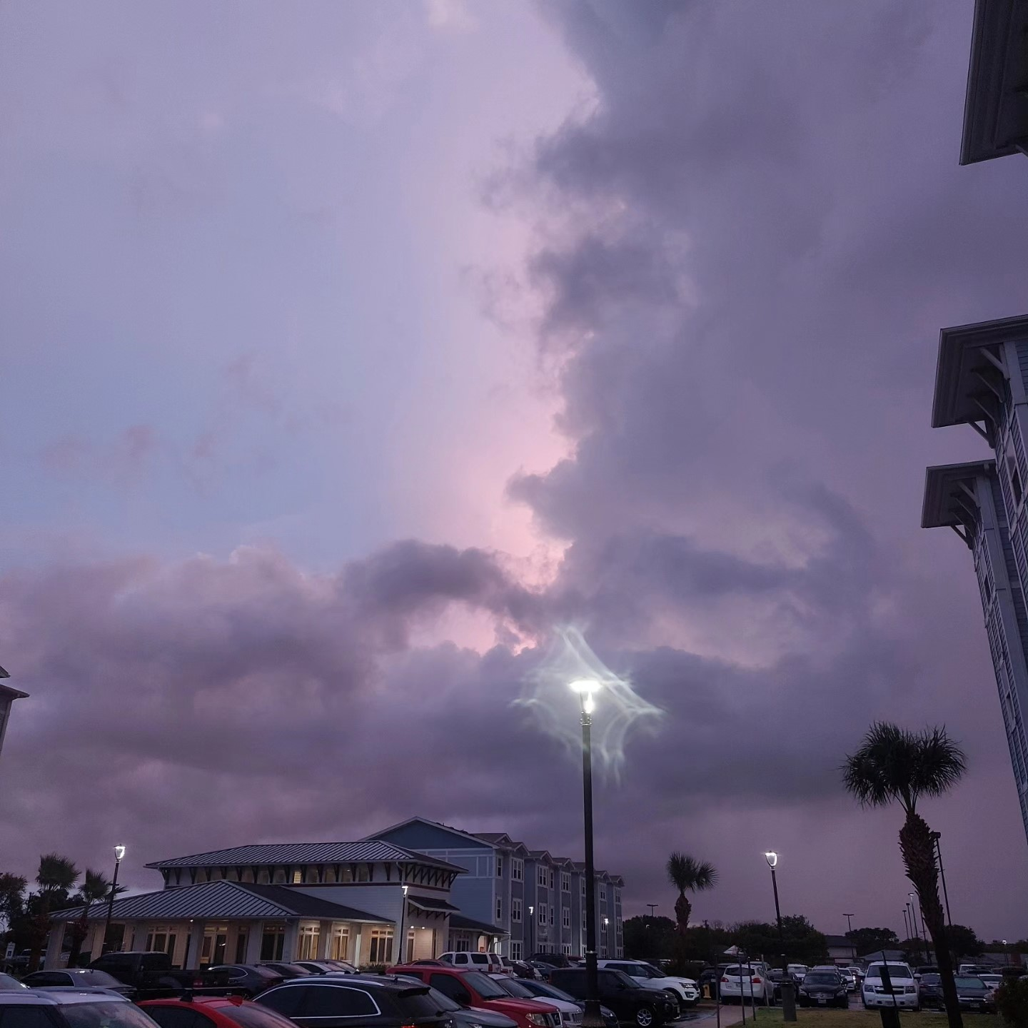
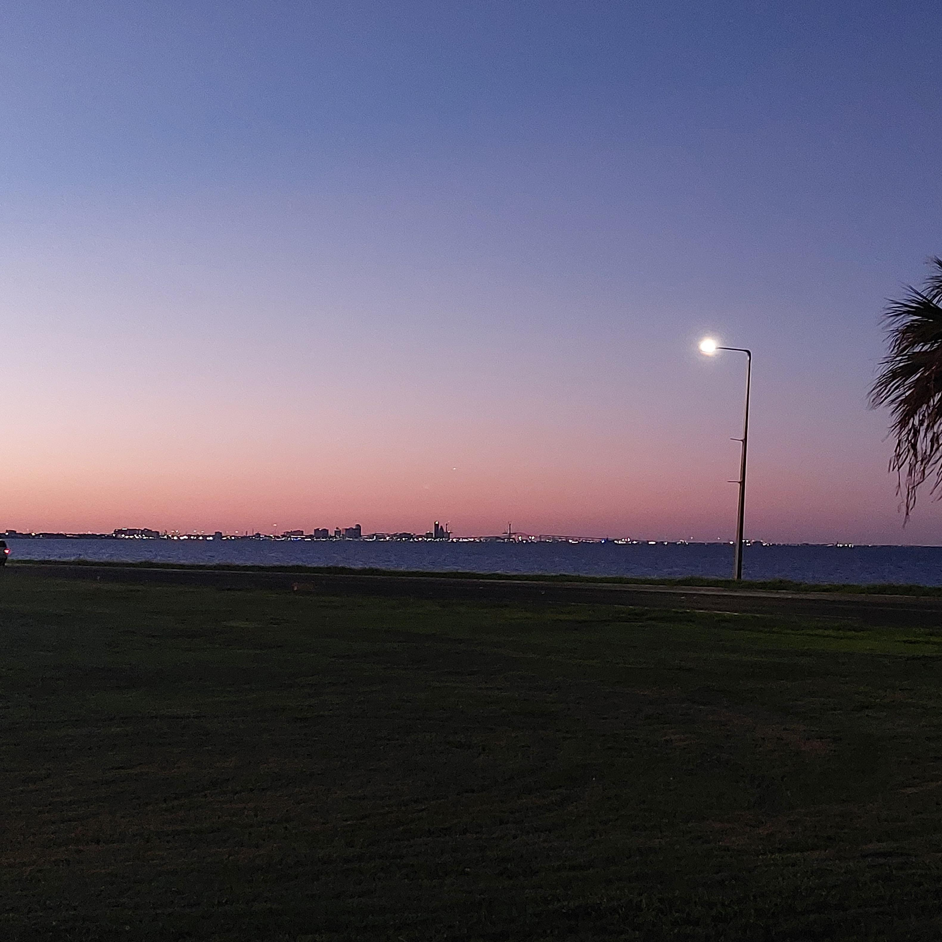
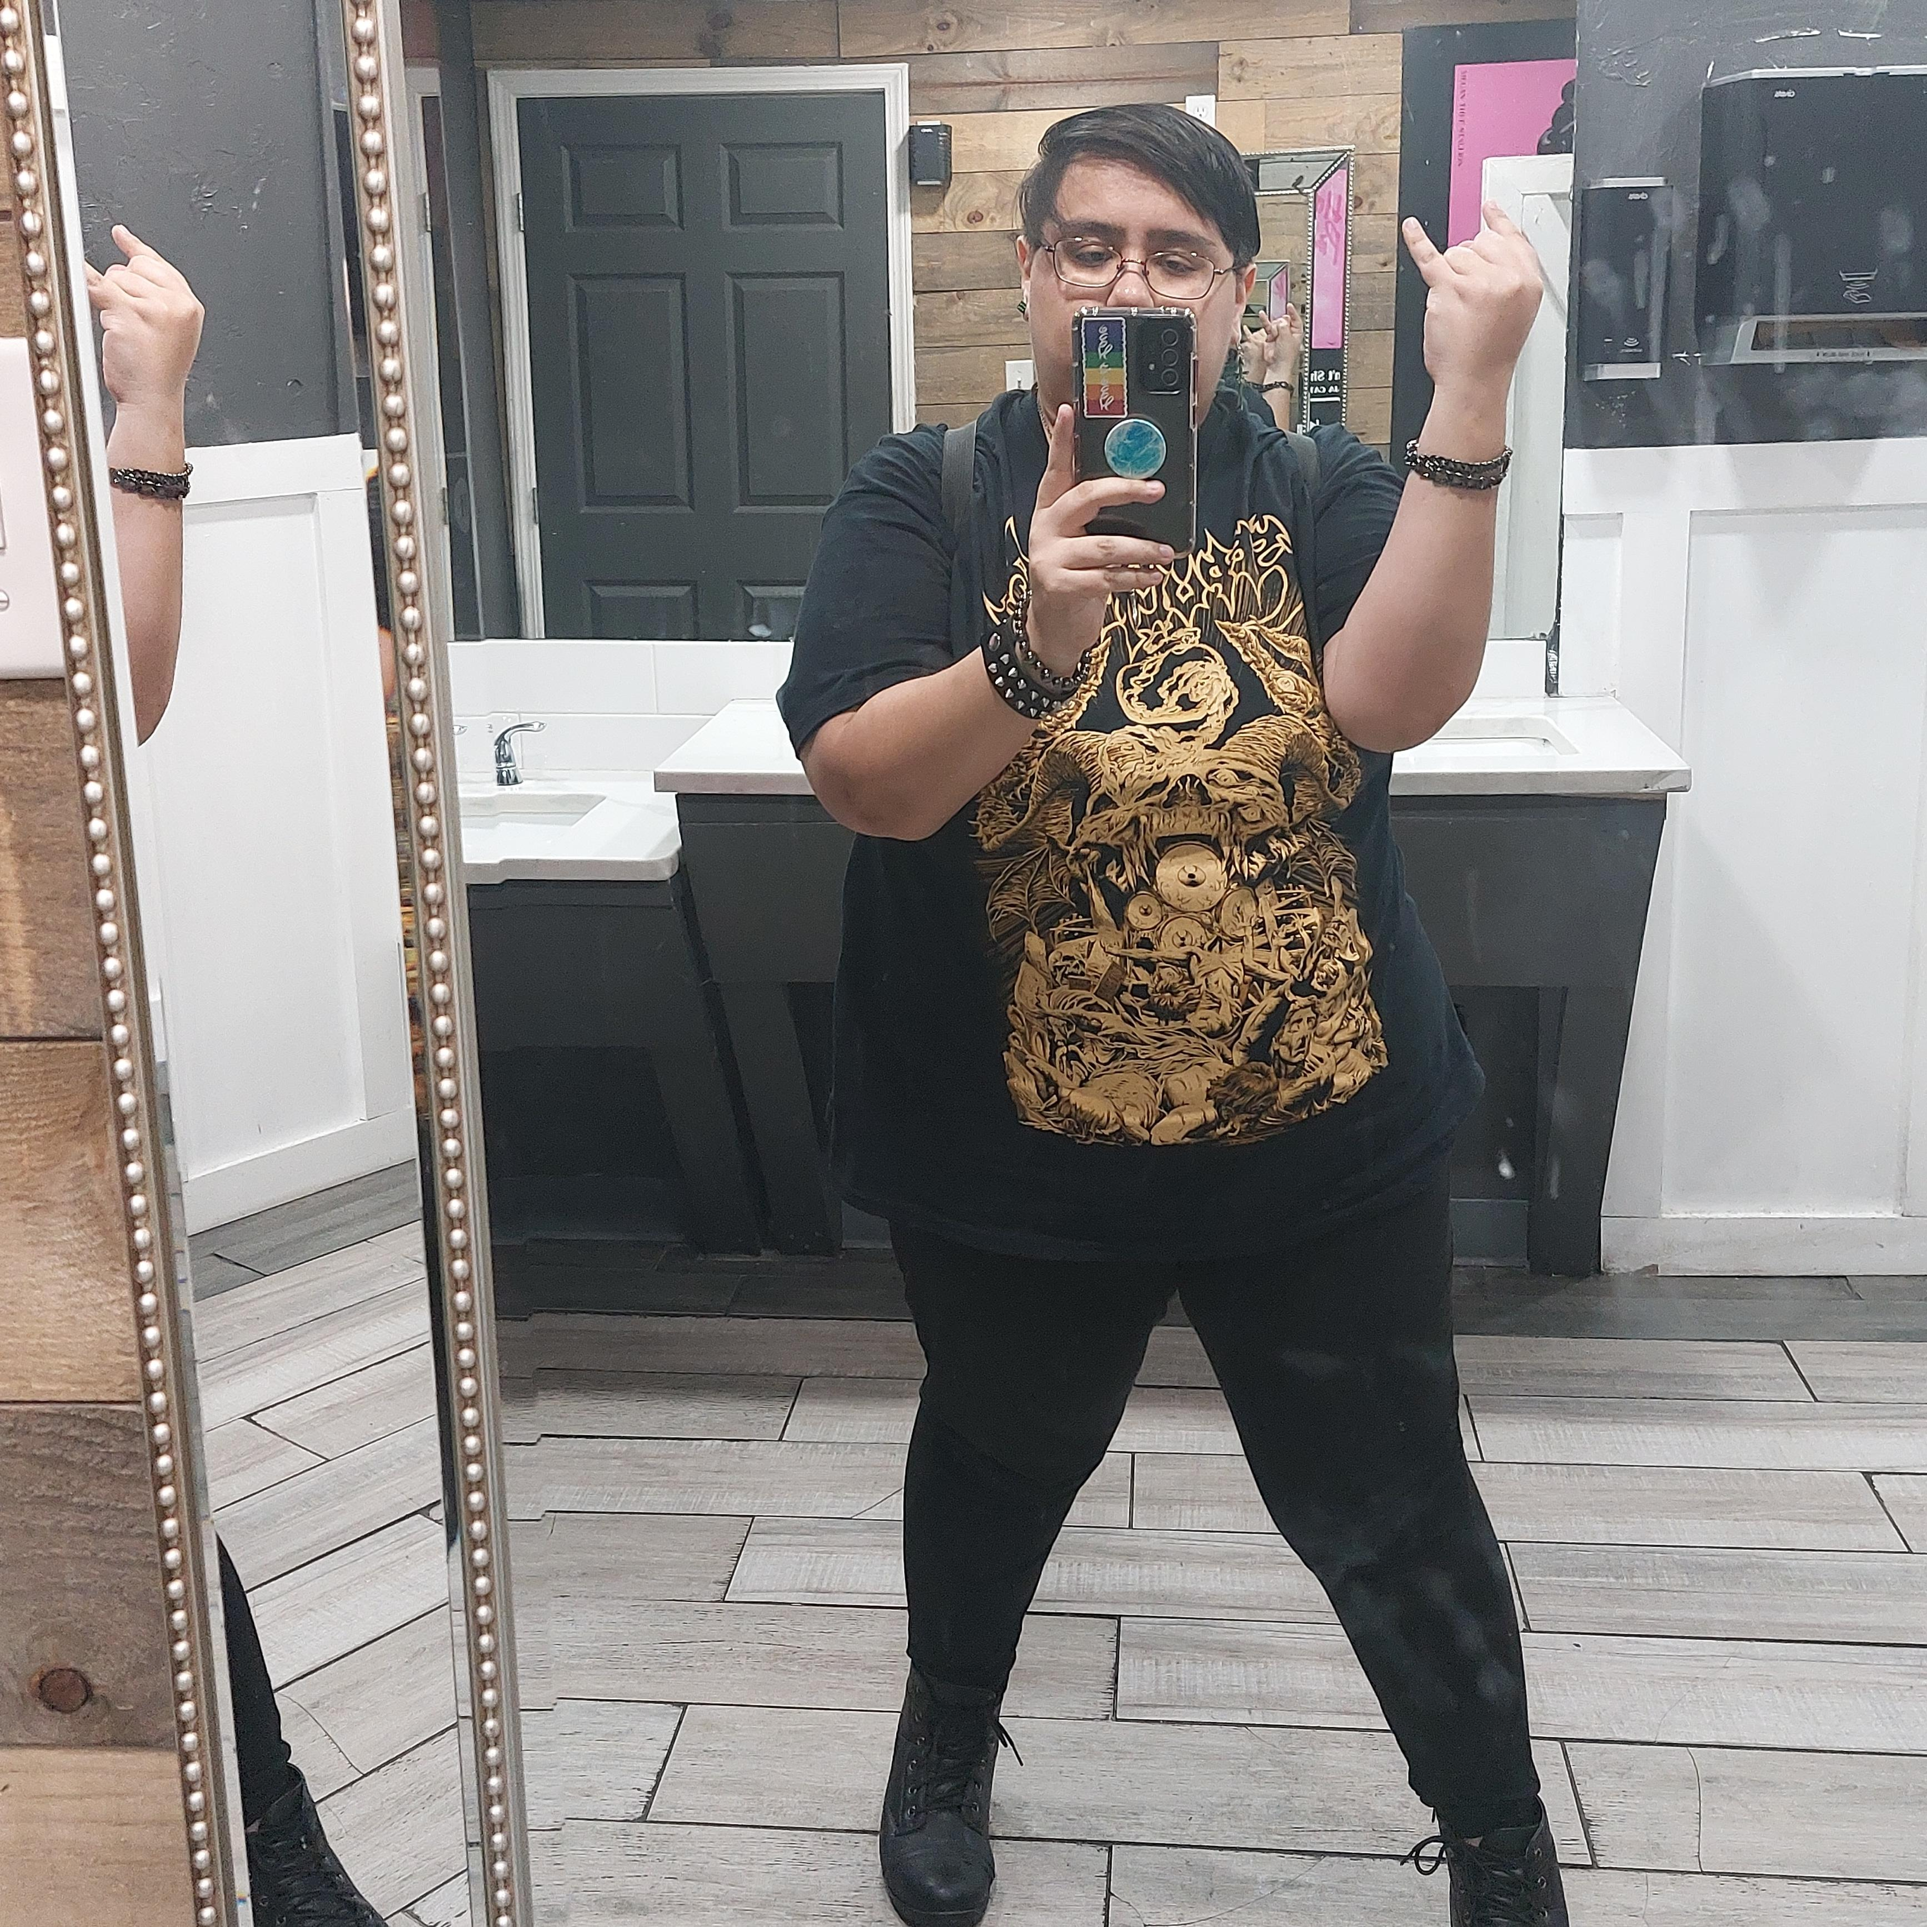
Online Presence in Fall 2023
Cheyenne N. Sanchez
Notes:
1st picture: https://www.instagram.com/p/Cz0NmJ7sn18/?igshid=MzRlODBiNWFlZA
2nd picture: https://www.instagram.com/p/Cyhe8V7sDk6/?igshid=MzRlODBiNWFlZA
3rd picture: https://www.instagram.com/p/Cx4Qh-mMXh2/?igshid=MzRlODBiNWFlZA
4th picture: https://www.instagram.com/p/Cw_idc_ROSU/?igshid=MzRlODBiNWFlZA

Slide 9
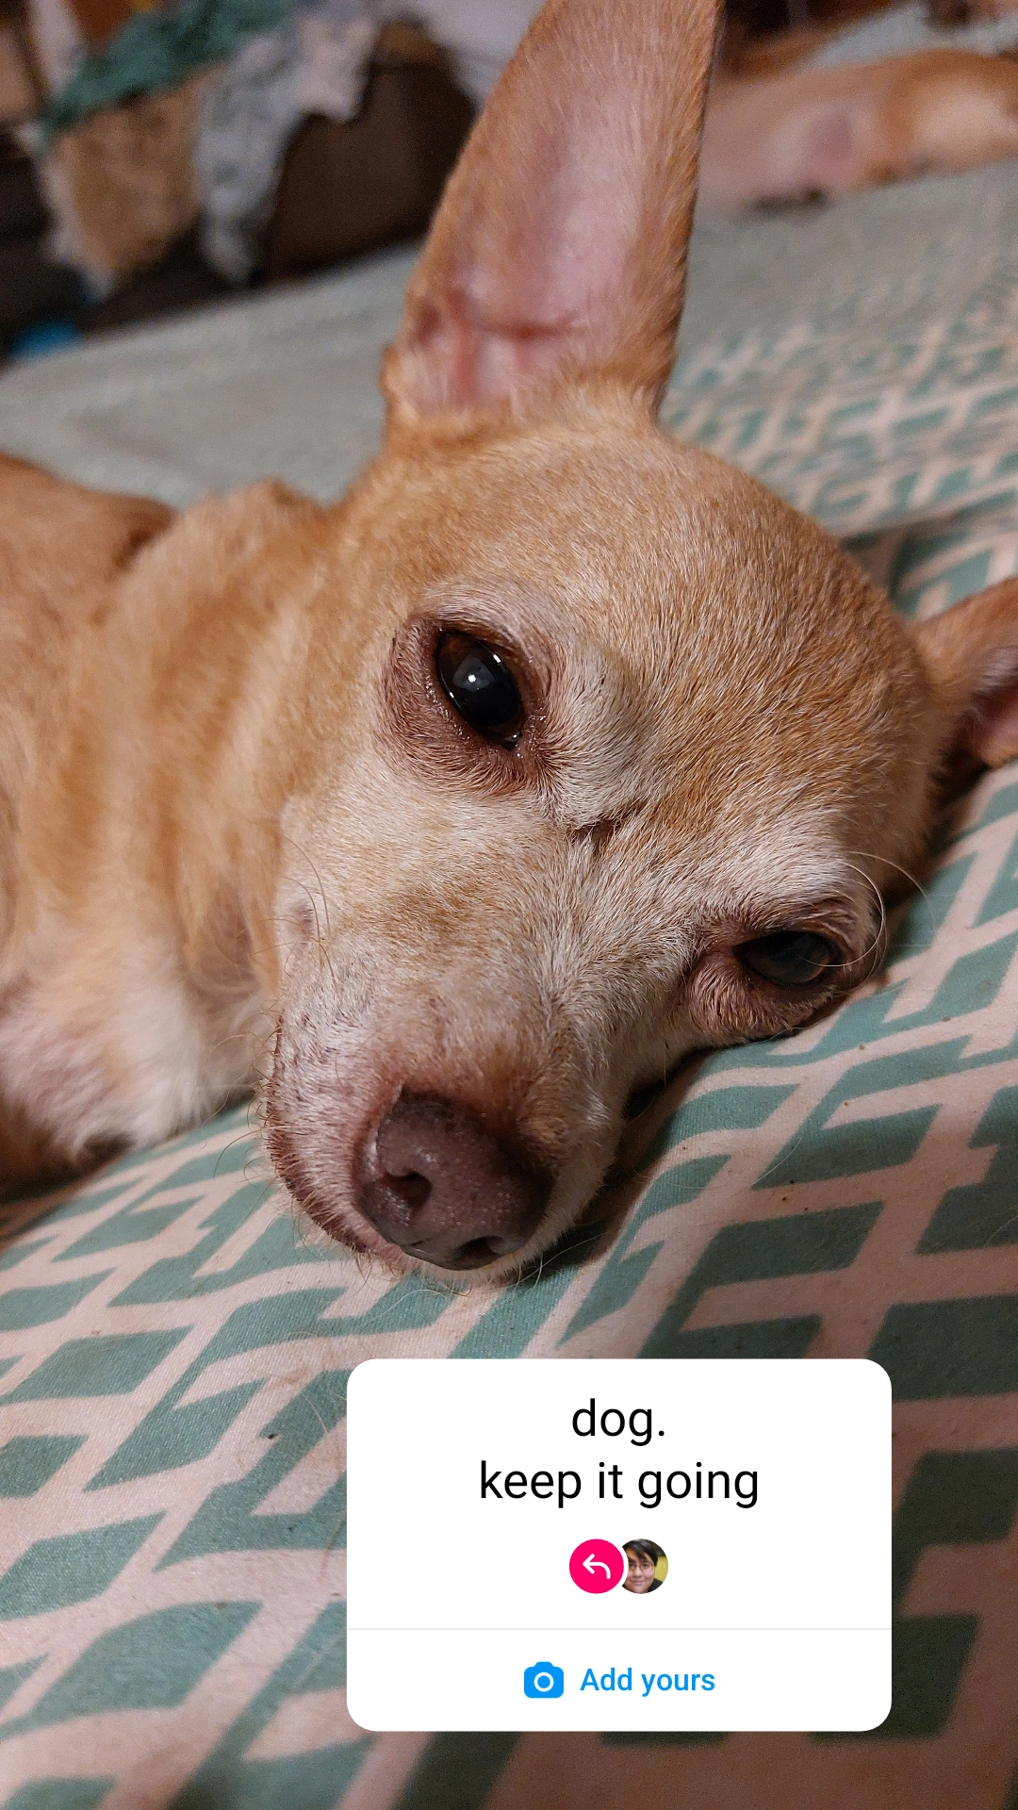
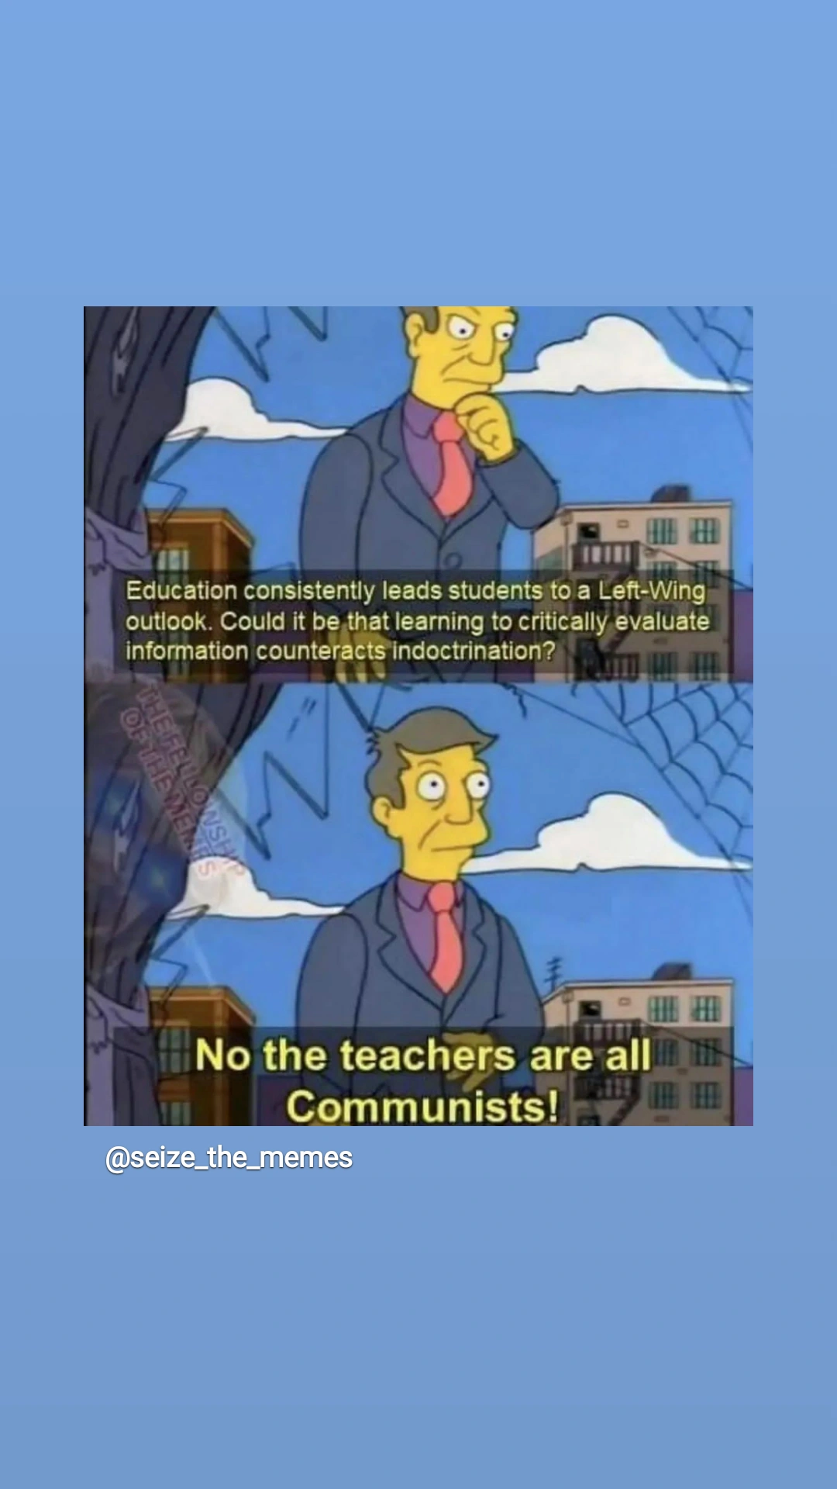
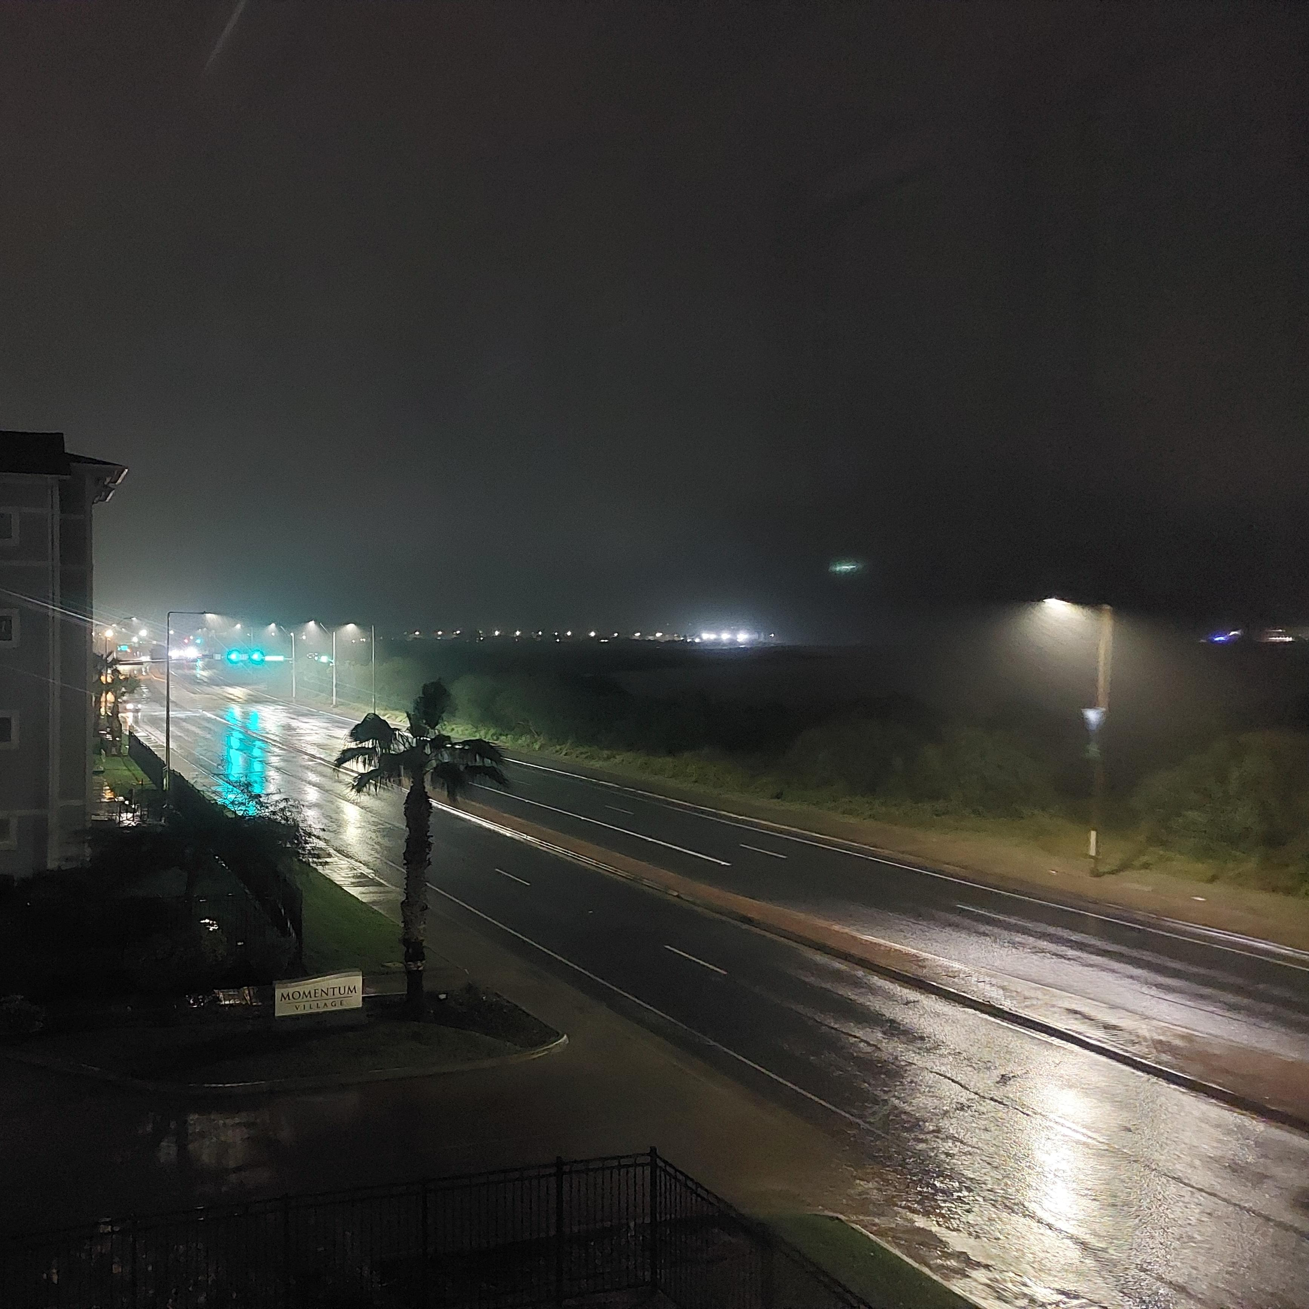
Notes:
Rainy sky post: https://www.instagram.com/p/CzkULIVs2Yh/?igshid=MzRlODBiNWFlZA
My first reel: https://www.instagram.com/reel/CyBvdxqR4Qn/?igshid=MzRlODBiNWFlZA
Please Don’t Judas Me by Nazareth: https://www.instagram.com/reel/C0bDhQtsq1c/?igshid=MzRlODBiNWFlZA

Slide 10
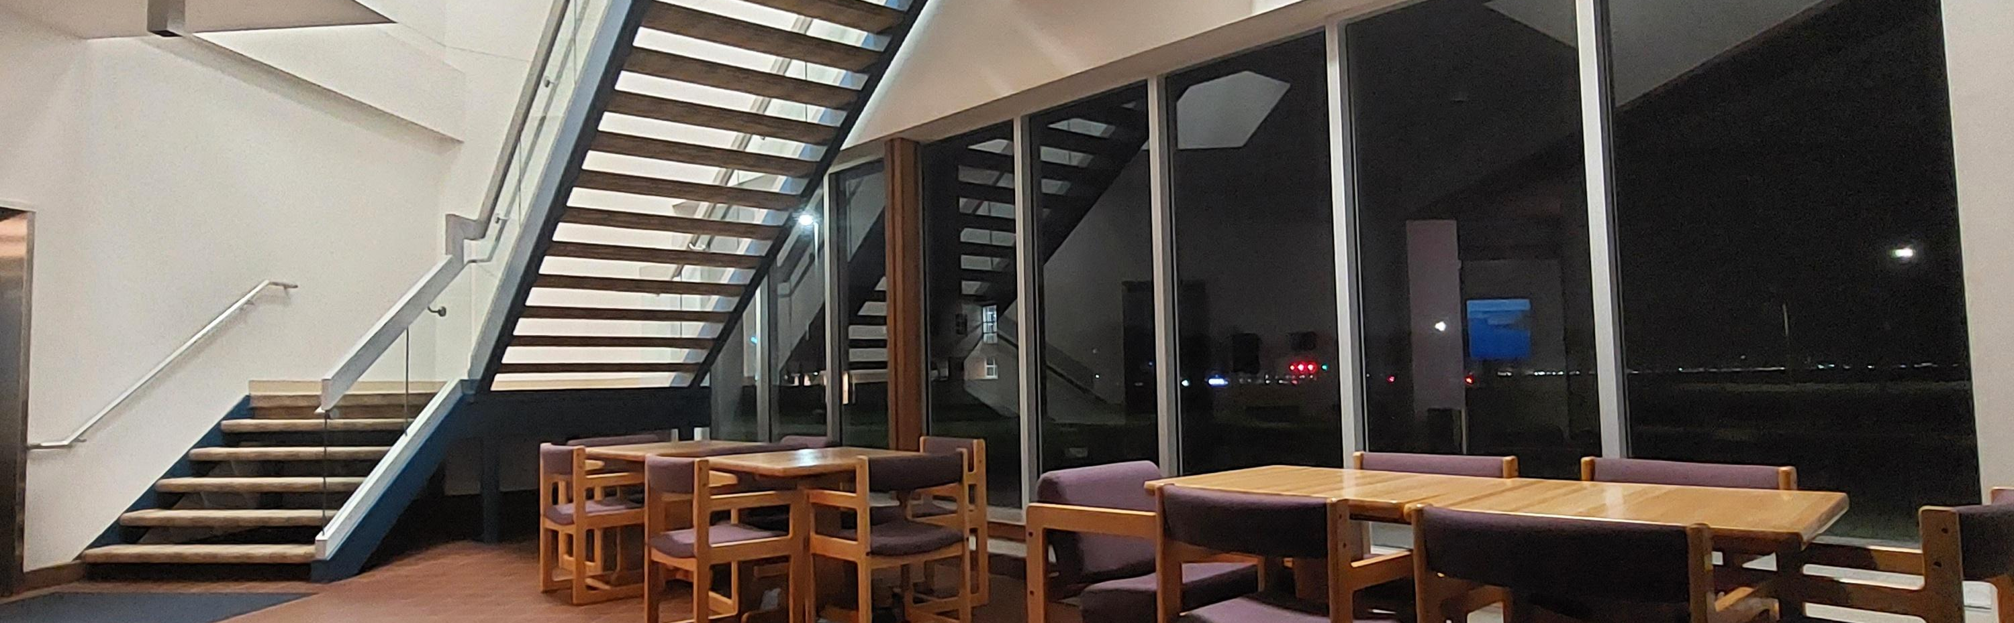
My Takeaways
If the definition of “text” has metamorphized starting from the release of the internet, then I am conveying text through creative means by captions of imagery and use of music. Music is text, even if instrumental. When I combine music with imagery and caption, I am integrating different forms of text to create an aesthetic of my social media presence. I utilize my online presence for expressing my creative streak with photography and poetics. I include hashtags to contribute to the tagged genres of Instagram and in hopes of attracting more views.
Notes:
My attempt at liminal space photography: https://www.instagram.com/p/CyzVSRnMenu/?igshid=MzRlODBiNWFlZA

